Slide 1
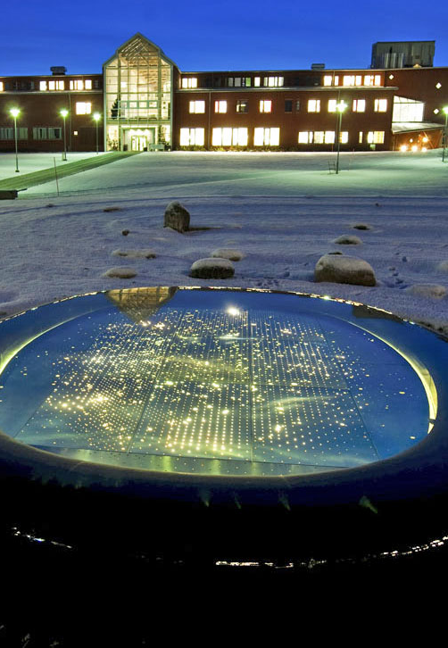

Syntactic Singular vs. Semantic Plural in Russian, Ukrainian, and beyond
What is (not) happening and how that might change in the age of AI
Laura A. Janda
(with Tore Nesset and Yuliia Palii)

Slide 2
Overview
How I got interested in this idea
Stability, variation, AI
Singular vs. Plural variation
Alternative construals of the “same” reality
Russian quantified subjects
Ukrainian subjects quantified by bahato

Slide 3
How I got interested in this idea Stability, variation, AI
Notes:
YP

Slide 4
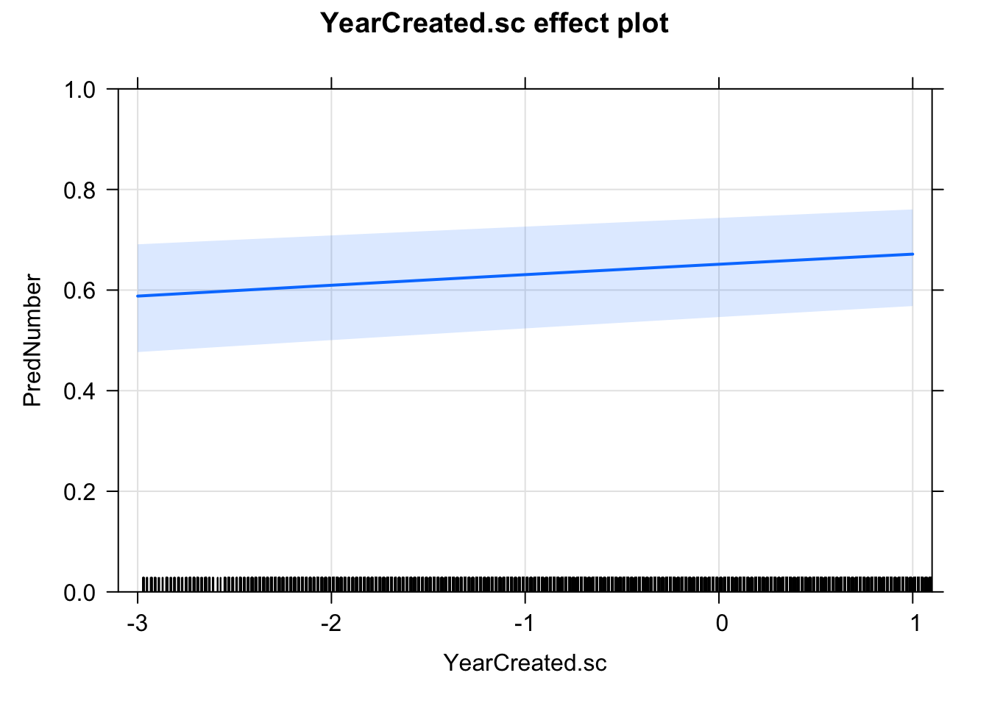
How I got interested in this topic
Y-axis is probability of PL
Nesset & Janda (2023) found that Singular (44%) vs. Plural (56%) variation in verbs with quantified subjects in Russian (e.g. ostalos’[sg]/ostalis’[pl] šest’ čelovek ‘six people remained’) has persisted nearly unchanged over the past 200 years
1800
2017
Surprising because Russian numeral morphosyntax has otherwise changed radically

Slide 5
The idea
Can LLMs impact the pace and direction of change?
The environment
Stable co-existence of variant forms in language is common, though often overlooked
Preponderance of machine-generated language
The issues
Do LLMs reproduce stable variation, or do they exaggerate biases?
If LLMs exaggerate biases, can they propel language change?

Slide 6

The one that got away…
A grant proposal submitted to the Norwegian Research Council
Missed funding by 1 point
My university gave me a postdoc position as a “consolation prize”

Slide 7
Language variation
When linguists look at variation, they tend to focus more on change than on stability
Exceptions: Longobardi 2001, Friðriksson 2008, Keenan 2009
Linguists tend to assume that variation must carry sociolinguistic indexical value (Weinreich et al. 1968, Milroy 1992, Croft 2000, Blythe & Croft 2012)
Exceptions: Lass 1997, Ajión-Oliva and Serrano 2013

Slide 8

Spread of change
The spread of language change (“transition” cf. Weinreich et al. 1968) is facilitated by the presence of “numerous weak [social] ties”, in particular “first-order ties” realized as direct linguistic interactions (Milroy 1992, 2002) that can propagate change across a speech community.
In other words: language change spreads when lots of people talk to one another

Slide 9
Locus and quality of change
Some have assumed that language change takes place at L1 acquisition (Andersen 1973 & 1989)
Some have assumed that language change is categorical
Others show evidence that language change takes place across the lifespan (Mechler & Buchstaller 2019)
Others show evidence that language change is gradual (Bybee & Beckner 2015)
If the “others” are right, adults are liable to make gradual changes in language based on their exposure to interactional use of language.

Slide 10

My colleague in the Computer Science Department at UiT, Dilip Prasad
“Laura, most of what’s on the internet is not going to be written by human beings.”
Thompson et al. (2024) estimate that a “shocking” 57.1% of texts on the Internet are machine-generated, a growing trend, particularly for low-resource languages targeted by multi-way machine translations.

Slide 11
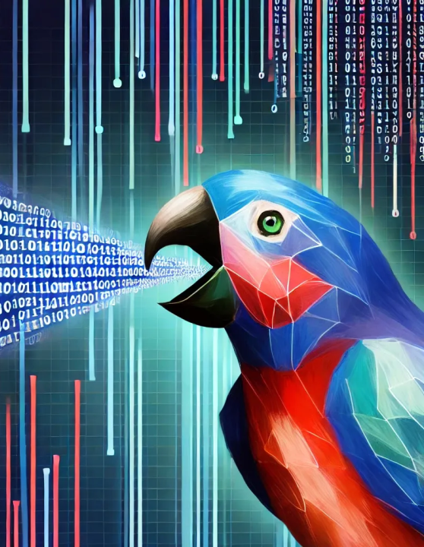
How LLMs work
An LLM tokenizes language into units and computes the probability of the next unit in a string
Bender et al. 2021 “On the Dangers of Stochastic Parrots”
LLMs tend to perpetuate and often exaggerate biases present in training data (Manning 2022)
BUT: no one has looked at grammatical bias in LLMs

Slide 12
Human-AI interaction on a massive scale
Millions (billions?) of people can converse with LLM-sourced chatbots on an unlimited and even intimate basis (cf. “numerous weak ties” and “first-order ties”)
We know that human beings are sensitive to frequency distributions in language (Bybee 2015)
Will LLMs serve the role of “sociolinguistic icons” (Eckert 2000) to which people accommodate their speech in a process of “koineization” (Kerswill 2002)?

Slide 13
Singular vs. Plural variation Alternative construals of the “same” reality
Notes:
YP

Slide 14
Singular vs. Plural (SvP) variation
Corbett (2000) describes number as at once deceptively simple, yet “the most underestimated of grammatical categories”, presenting complex facts that differ across languages.
Grammatical number is the context for many types of variation, such as syntactic Singular agreement motivated by a Singular noun vs. semantic Plural agreement motivated by the fact that the noun refers to a multitude of individuals. This tug-of-war between syntax and semantics lies at the heart of controversies about grammatical agreement (Corbett 2006, Kibrik 2019).

Slide 15
Plurals and Masses in English grammar
Johnson (1987: 26) the same group of objects can be construed both as a mass and as a number of individuals
Lakoff (1987: 427–428) and Langacker (2008: 130–140):
masses portrayed as “non-plural mass” (sand) vs. “plural mass” (cats)
(1) all/most sand/cats/*cat
(2) They’re looking for *cat/sand/cats.
(3) a cat/*sand/*cats
(4) those/these/many/few/several/numerous cats vs. that/this/much/little sand
(5) three cats/*sand
Mass and Plural behave the same way

Slide 16
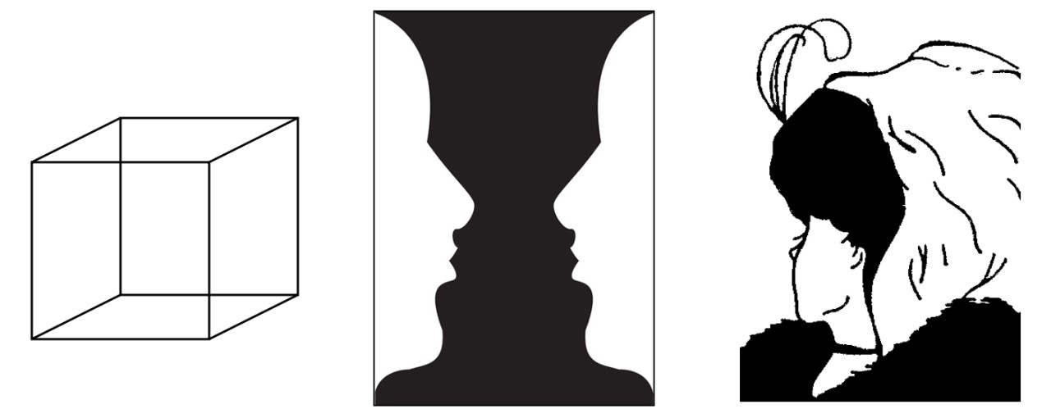
Alternative construals as either mass or multiplex
cf. Langacker (2008: 131), Johnson (1987: 26)
Non-plural Mass Noun
Plural Mass Noun
Cognitive multistability (Stadler & Kruse 1995),
similar to ambiguous figures
Notes:
LAJ

Slide 17
Agreement, variation, learnability
In 1922, three years after the resumption of football, Manchester United was relegated to the Second Division.
At the end of the 1921–22 season, Manchester United were relegated to the Second Division, having won only eight games.
Quantifier
Semantic type
Distance
Semantic type
Animacy
relation
CONTROLLER
TARGET
Frequency
Modifier
Word order
Part of speech
Agreement = “systematic covariance between a semantic or formal property of one element and a formal property of another” (Steele 1978)
Notes:
Sources:
Example with singular: https://americanreddevils.com
Example with plural: https://en.wikipedia.org

Slide 18
Russian quantified subjects
Notes:
YP

Slide 19
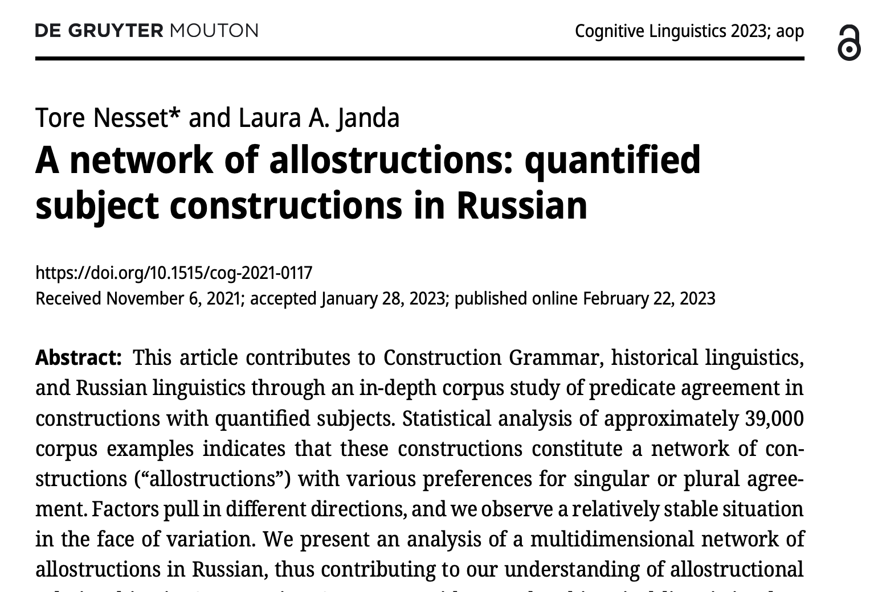

Slide 20
Case Study 2: Russian quantified NP + verb ‘Six persons remained.SG/remained.PL’
SG
Baseline:
56% PL
Factors:
Nominative premodifier
Year Created
Quantifier Frequency
Quantifier Type
Animacy
Word Order
Quantifier Lemma
Verb Lemma
Quantified NP
PL
Quantified NP
Data:
38,988 examples from Russian National Corpus
36,182 examples after removal of nominative premodifiers

Slide 21
Nominative premodifiers: “These two professors gave a talk”
NomPs >> Pl in the literature:
Crockett 1976
Rozental’ and Telenkova 1976
Švedova 1980
Kuz’minova 2004
Timberlake 2004
Pereltsvaig 2006
From 38,988 examples,
2,806 have NomPs:
2,801 have PL verb
5 have SG verb!
Since this is a (nearly) categorical rule, this factor was excluded from statistical model
Confirmation of hypothesis that NomPs >> PL
New: Cue reliability = 99.8%, but cue availability = 7.2% and cue validity < 7.2%

Slide 22
Things to wrap your head around concerning numerals 2-900...
Q: Which numerals are more likely to support a plural interpretation, and which ones are more likely to support singular?
A: Smaller numerals allow for more individuation, thus supporting more plural, whereas large numerals are more indicative of masses that are perceived as wholes and therefore singular
Q: Which numerals are of high frequency and which are of low frequency?
A: Small numerals (2, 3, 4, etc.) are of higher frequency, bigger numerals have progressively lower frequency
Larger numerals are of lower frequency and tend to have singular agreement.
Smaller numerals are of higher frequency and tend to have plural agreement.

Slide 23
Mixed effects logistic regression model for predicting Predicate Number
PredNumber ~ 1 + YearCreated.sc + LogQuantFreq.sc + QuanType + Animacy * WordOrder + (1|Quantifier) + (1|VerbLemma)
“Predicate Number is predicted in relation to an overall intercept (1), with main effects of Year Created, Quantifier Frequency, and Quantifier Type, an interaction between Animacy and Word Order, and random effects of Quantifier and Verb Lemma”
Correct predictions for 84.2% of the data, well above the baseline of 55.96%; C score is 0.922

Slide 24
Results of logistic regression model for fixed effects
 | Estimate | Std. Error | z value | Pr(>|z|)
(Intercept) | 1.20724 | 0.30691 | 3.933 | 8.37e-05 | ***
YearCreated.sc | 0.08970 | 0.01610 | 5.571 | 2.53e-08 | ***
LogQuantFreq.sc | 0.39513 | 0.11103 | 3.559 | 0.000373 | ***
QuanTypecollective | -0.88051 | 0.46554 | -1.891 | 0.058576 | .
QuanTypenumeral | -2.03981 | 0.34382 | -5.933 | 2.98e-09 | ***
QuanTypeindefinite | -4.60623 | 0.41864 | -11.003 | < 2e-16 | ***
Animacyanim | 0.98308 | 0.04317 | 22.771 | < 2e-16 | ***
WordOrderSV | 1.28468 | 0.04896 | 26.239 | < 2e-16 | ***
Animacyanim:WordOrderSV | 0.59289 | 0.07251 | 8.177 | 2.91e-16 | ***
A number of factors influence the choice between SG and Pl agreement.
One interaction is detected: Animacy and word order.

Slide 25
Language change? Year Created
Y-axis is probability of PL
Year of origin scaled (z-scored)
1800 = -2.97 (minimum)
1949 = 0 (mean)
2017 = 1.37 (maximum)
Some claim plural agreement has increased:
Gorbačevič 1971
Rozental’ 1974
Others find no evidence of change:
Corbett 1981
1800
2017
Confirmation of hypothesis that situation is stable over time: “Static variation”
Surprising: Russian numeral morphosyntax has otherwise changed radically.

Slide 26
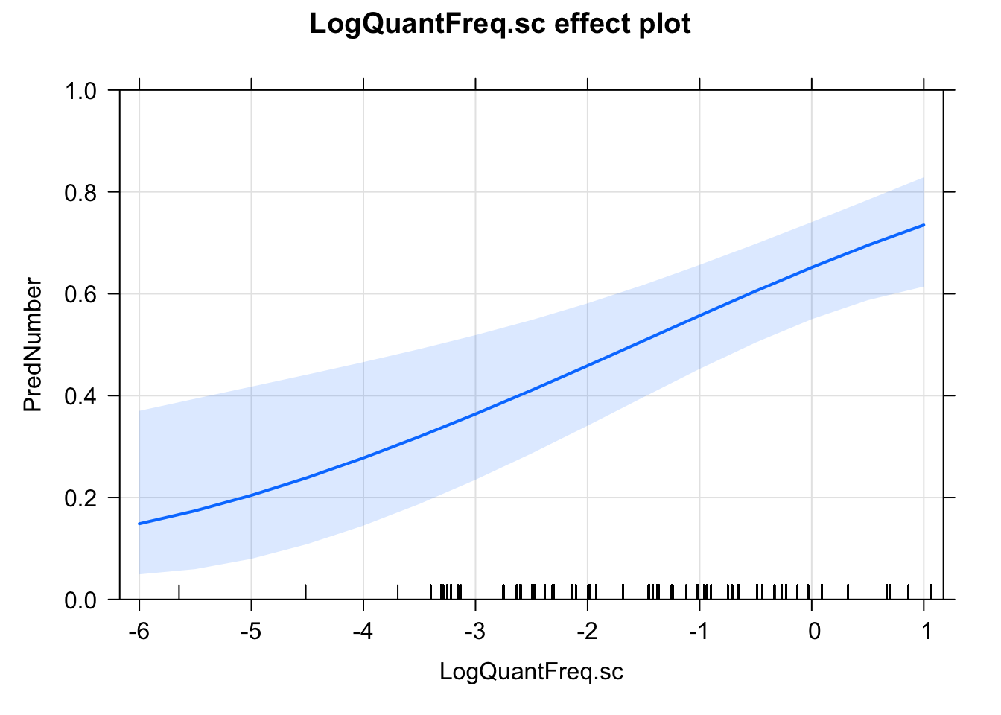
Quantifier Frequency
Y-axis is probability of PL
Quantifiers have different frequencies in Russian National Corpus:
vosem’sot ‘800’: 1,802 attestations
dva ‘2’: 316,172 attestations
Corpus frequency of each quantifier logarithmically transformed and scaled (z-scored):
97 = -5.65 (minimum)
159,318 = 0 (mean)
352,781 = 1.07 (maximum)
Low frequent quantifier
High frequent quantifier
PL agreement is more likely to occur if the quantifier is of high frequency

Slide 27
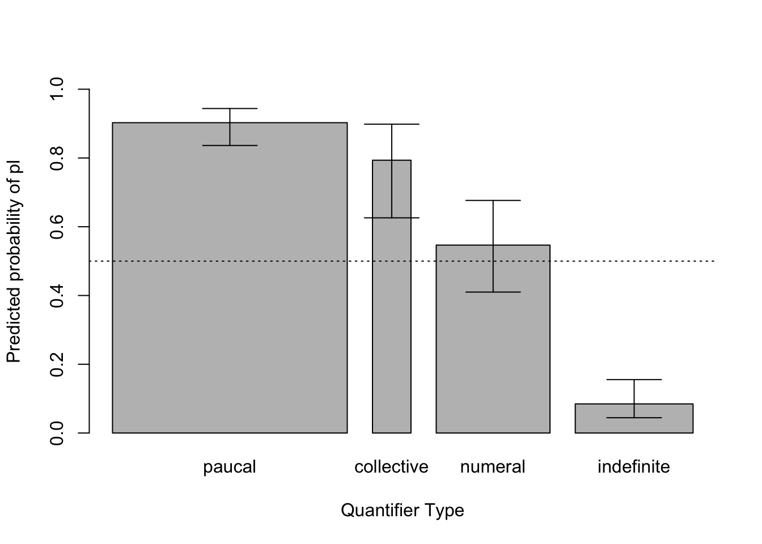
Quantifier Type
Y-axis is probability of PL
Paucal: ‘2’, ‘3’, ‘4’, ‘both’, ‘one and a half’
stem etymologically from adjectives; NP has unique syntax
considered distinct by Corbett 1993; Pereltsvaig 2010; Igartua and Madariaga 2018
Collective: ‘twosome’, ‘threesome’, ... ‘tensome’
used with human and pluralia tantum referents; NP in Genitive Plural
Numeral: ‘5’ and above
stem etymologically from nouns; NP in Genitive Plural
Indefinite: ‘many’, ‘some’, ‘how many’, ...
NP in Genitive Plural
Likelihood of PL agreement:
Paucal >> collective >> numeral >> indefinite

Slide 28
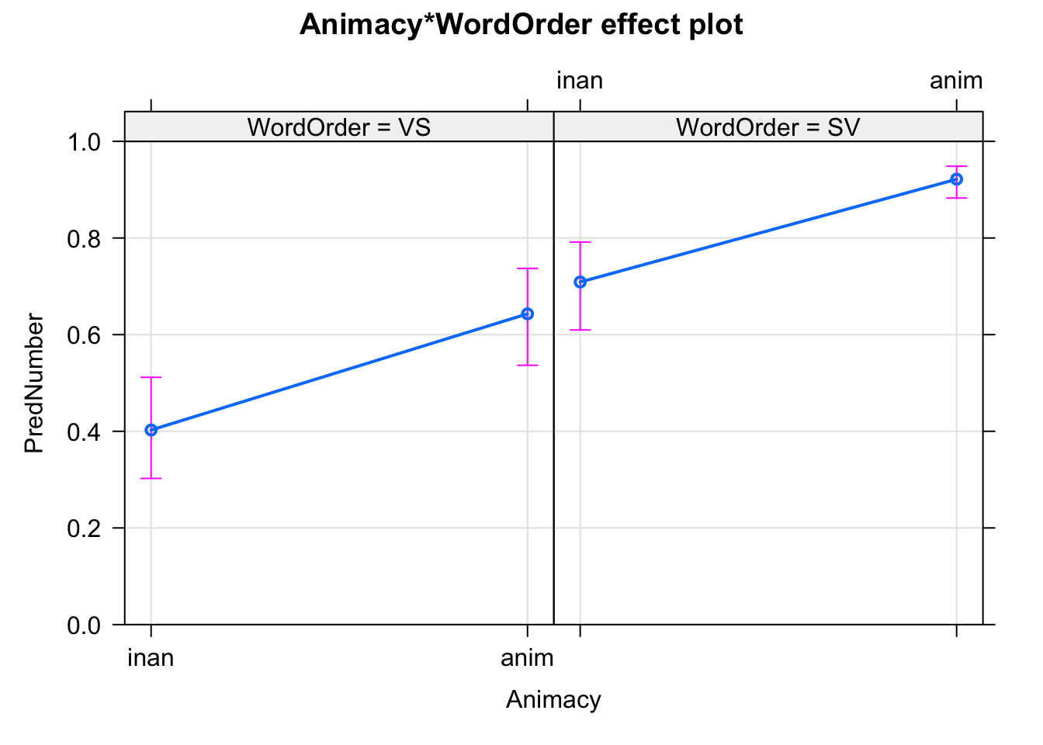
Interaction of Animacy and Word Order
Y-axis is probability of PL
Regression model finds interaction between animacy and word order
Four possible combinations
S_{ANIM}V
S_{INAN}V
VS_{ANIM}
VS_{INAN}
VS_{INAN}
VS_{ANIM}
S_{INAN}V
S_{ANIM}V
Likelihood of PL agreement:
S_{ANIM}V >> S_{INAN}V / VS_{ANIM} >> VS_{INAN}

Slide 29
Random effects 1: Quantifier lemmas
Four types of quantifiers are important:
Paucal, collective, numeral, indefinite
Do individual lexemes within each group behave differently?
If so, are there any patterns?
Case 1: Paucals ranked
obe ‘both’ (fem)
oba ‘both’ (masc/neut)
dve ‘two’ (fem)
četyre ‘four’
dva ‘two’ (masc/neut)
tri ‘three’
poltory ‘one and a half’ (fem)
poltora ‘one and a half’ (masc/neut)
Case 2: Indefinites ranked
neskol’ko ‘some’
nemnogo ‘not many’
nemalo ‘not few’
malo ‘few’
stol’ko ‘so many’
mnogo ‘many’
skol’ko ‘how many’
Definite:
‘both’ ≈ ‘the two’
Definiteness effect:
Definite >> other
Behaves like a numeral
FEM
>> MASC/NEUT
FEM
>> MASC/NEUT
FEM
>> MASC/NEUT
Definite promotes PL agreement (paucals)
Feminine promotes PL agreement (paucals)
Lexical items may show idiosyncratic behavior (neskol’ko)

Slide 30
Random effects 2: Verb lemmas
Do individual verbs have different preferences?
Investigated lemmas attested over 100 times (57% of total), remainder listed as NotLemmatized
Case 1: Semantic types of predicates
Robblee 1993: Agentive (e.g. ‘work’) >> Intransitive (e.g. ‘be located’) >> “Inversion” (e.g. ‘be’)
Our data provide some support: Agentive predicates generally promote PL agreement.
Situation may be more complex than Robblee anticipated.
Case 2: Constructions
Emu ispolnitsja_{SG} pjat’ let. ‘He turns_{SG} five years old.’
Prošlo_{SG} dve nedeli. ‘Two weeks went_{SG} by.’
Na remont ušlo_{SG} dva milliona dollarov. ‘Two million dollars were spent_{SG} on the renovation.’
Measurement of time or other resource: always SG agreement (regardless of semantics of verb)
Semantic types of predicates are relevant:
Agentive predicates promotes PL
Constructions are relevant
Measurement of time/resource promotes SG

Slide 31
Russian quantified subjects: summary
Premodified quantified subjects prefer PL (nearly categorical rule)
Relatively stable variation 44% SG vs. 56% PL
Low frequent (large) quantifiers prefer SG, High frequent (small) quantifiers prefer PL
Paucals and collectives prefer PL, indefinites prefer SG, others about 50-50
Animate SV prefers PL, VS inanimate prefers SG
Quantifiers and verbs have individual preferences
Measure constructions prefer SG
Notes:
Sources:
Example with singular: https://americanreddevils.com
Example with plural: https://en.wikipedia.org

Slide 32
Ukrainian subjects quantified by bahato
Notes:
YP

Slide 33
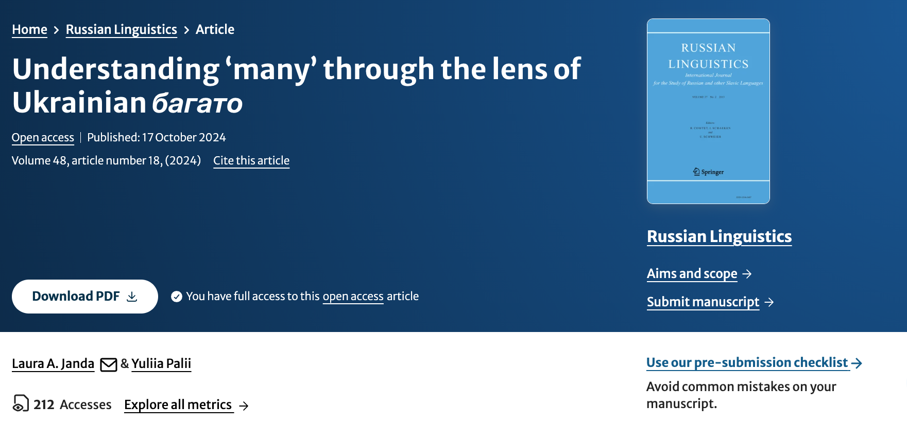
https://link.springer.com/article/10.1007/s11185-024-09301-7

Slide 34


багато людей...
‘many people’
прийшло ‘came’ (SG)
прийшли ‘came’ (PL)
Direction of historical development
Notes:
LAJ

Slide 35
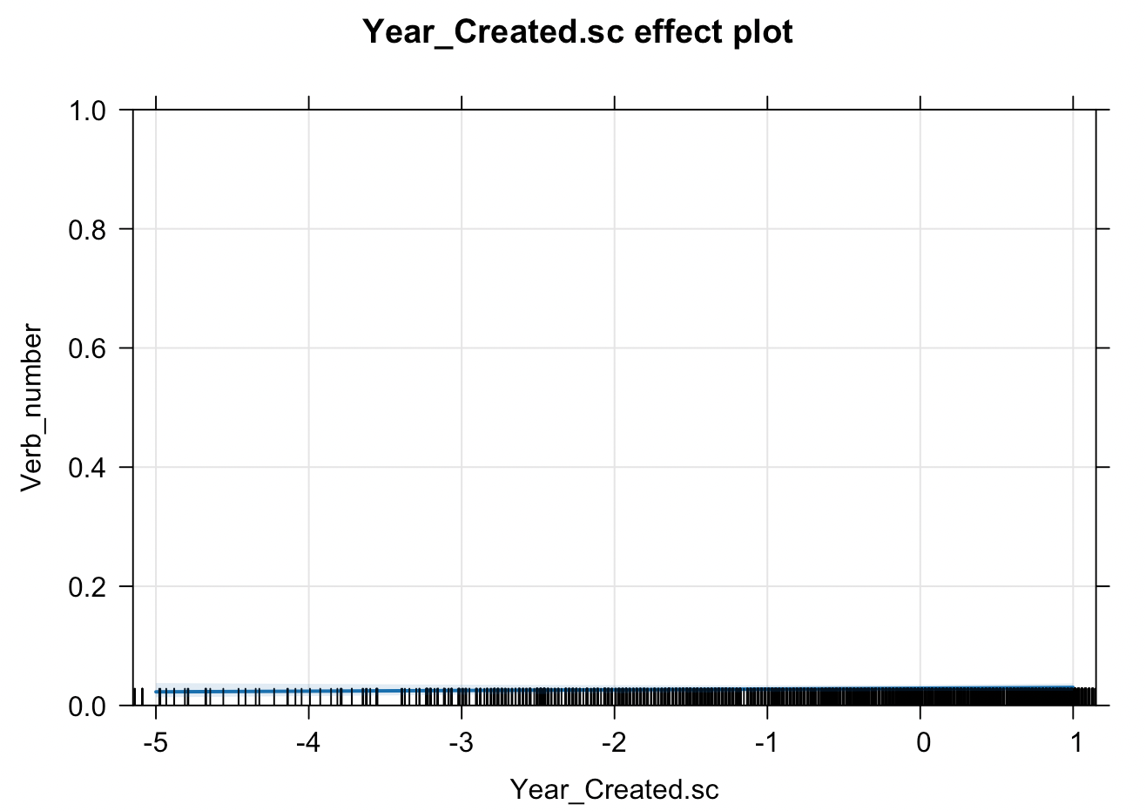
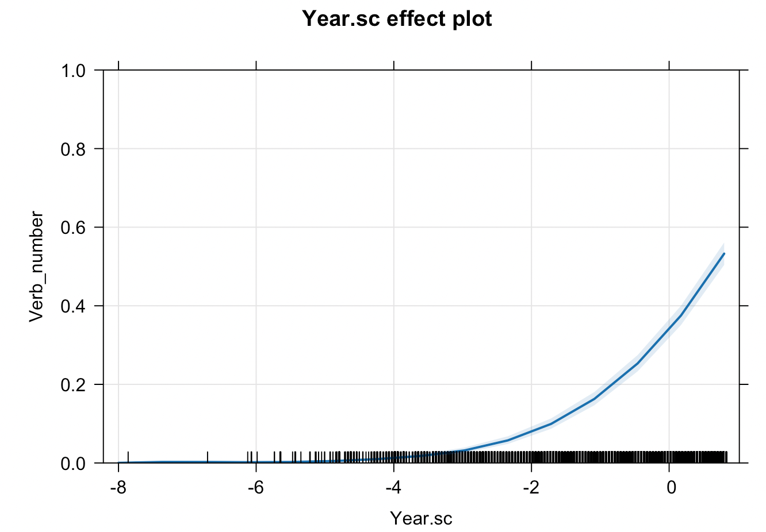
Russian много
Ukrainian багато
Percent PL
Percent PL
1742
2021
1819
2023
Effect plot based on
logistic regression
6 612 observations from Russian National Corpus
Baseline: 94.7% SG verb forms
(other factors: word order, animacy)
Effect plot based on
logistic regression
28 491 observations from GRAC
Baseline: 69.1% SG verb forms
(other factors: word order, animacy, verb lemma)
Notes:
LAJ

Slide 36
Prediction of Plural by fixed effects of mixed-effect logistic regression model
 | Estimate | Standard Error | z value | Pr (>|z|)
(Intercept) | -2.15067 | 0.07040 | -30.55 | < 2e-16 | ***
Year.sc | 0.93924 | 0.02988 | 31.44 | < 2e-16 | ***
Animacyanim | 0.62370 | 0.05320 | 11.72 | < 2e-16 | ***
Word_orderSV | 3.01155 | 0.04991 | 60.34 | < 2e-16 | ***
Intercept: Year.sc = 0.0 (= 2004), Animacy = inanimate, Word Order = VS
Notes:
LAJ

Slide 37
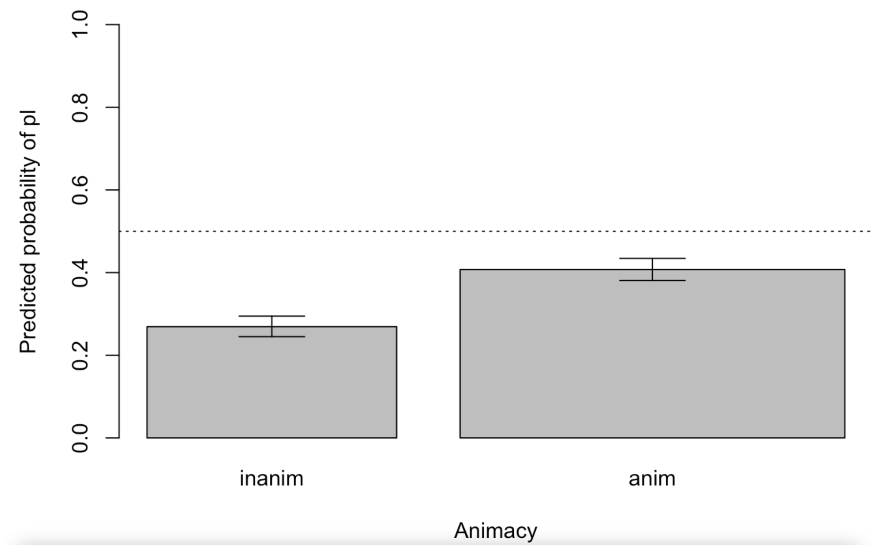
Predicted values for Animacy
Notes:
LAJ

Slide 38
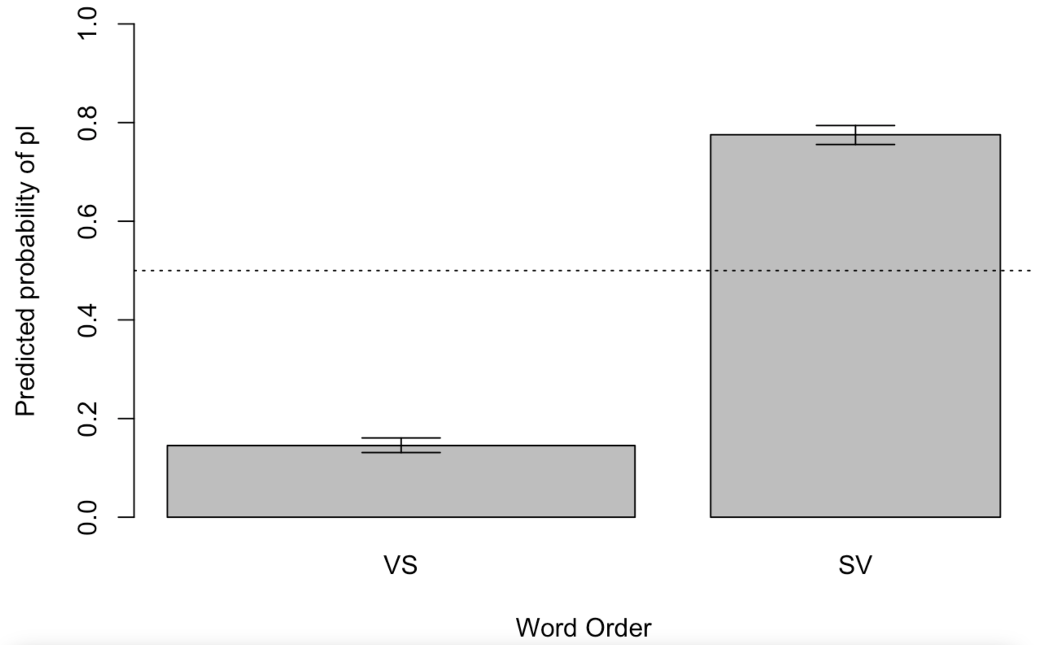
Predicted values for Word Order
Notes:
LAJ

Slide 39
Top 10 high-frequency verbs with strongest preference for Singular |  | Top 10 high-frequency verbs with strongest preference for Plural
минути ‘pass’ | 307 | розкритикувати ‘criticize’ | 21
відбутися ‘happen’ | 24 | засудити ‘condemn’ | 20
надійти ‘tun up’ | 204 | ввести ‘bring in, introduce’ | 21
виникнути ‘arise’ | 274 | заявити ‘declare’ | 43
виникати ‘arise’ | 102 | очікувати ‘expect’ | 26
накопичитися ‘accumulate’ | 140 | відзначати ‘mark, notice’ | 27
статися ‘happen’ | 107 | відчути ‘feel’ | 30
надходити ‘come’ | 84 | висловити ‘express’ | 50
полягти ‘perish’ | 44 | отримати ‘get’ | 129
назбиратися ‘gather, come together’ | 52 | пережити ‘experience’ | 23
Verb lemmas that appear in twenty or more examples and are ranked by the model at the extremes of a distribution from preference for Singular to preference for Plural. Shading indicates verbs with 100% of observations of only Singular or only Plural.
Notes:
YP

Slide 40
Case studies of verbs that strongly prefer SG: micro-constructions
PASSAGE OF TIME
HAPPEN
EXIST
ACCUMULATE
DIE
Together, the 28 verbs in these 5 semantic groups appear in 12,305 examples, constituting 43% of our total dataset
Notes:
YP

Slide 41
Group | Verb | N exx | % Sg | % VS | % inanim
passage of time | минути ‘pass’ | 307 | 100 % | 87 % | 100 %
 | пройти ‘pass’ | 203 | 78 % | 81 % | 68 %
І хоча минуло багато років, вона про цю подію розповідала з великим хвилюванням. (Інтернет-газета «Високий замок», 2003)
‘And although many years have passed, she talked about this event with great excitement.’
Common subjects: день ‘day’, місяць ‘month’, рік ‘year’
Notes:
YP

Slide 42
Group | Verb | N exx | % Sg | % VS | % inanim
happen | відбуватися ‘happen’ | 307 | 100 % | 87 % | 100 %
 | відбутися ‘happen’ | 24 | 100 % | 4 % | 100 %
 | виникнути ‘arise’ | 274 | 99 % | 89 % | 100 %
 | виникати ‘arise’ | 102 | 99 % | 81 % | 98 %
 | статися ‘happen’ | 107 | 99 % | 78 % | 99 %
Відтоді багато змін відбулося в житті актриси і мами. (Інтернет-газета «Дзеркало тижня», 2017)
‘Since then, many changes have taken place in the life of the actress and mother.’
Принаймні в автора цих рядків до режисера виникло багато запитань. (Інтернет-газета «Україна молода», 2012)
‘The author of these lines at least had many questions for the director.’ [literally: there arose many questions]
Notes:
YP

Slide 43
Group | Verb | N exx | % Sg | % VS | % inanim
exist | точитися ‘exist’ | 46 | 100 % | 91 % | 100 %
 | існувати ‘exist’ | 62 | 100 % | 95 % | 94 %
 | лежати ‘exist’ | 53 | 98 % | 81 % | 62 %
 | бути ‘be’ | 8257 | 93 % | 83 % | 54 %
 | знайтися ‘exist’ | 57 | 100 % | 95 % | 19 %
Потім точилося багато розмов про матеріальну підтримку своєї збірної від вірменської діаспори. (Інтернет-газета «Високий замок», 2003)
‘Then there were many conversations about the material support of the national team from the Armenian diaspora.’
У відділенні лежало багато хворих (Онлайн-ЗМІ «UNIAN.NET», 2020)
‘There were many patients in the ward’
when people are referred to, they have limited or subjugated agency
Notes:
YP

Slide 44
Group | Verb | N exx | % Sg | % VS | % inanim
accumulate | нагромадитися ‘accumulate’ | 23 | 100 % | 83 % | 100 %
 | накопичитися ‘accumulate’ | 140 | 99 % | 89 % | 100 %
 | надійти ‘show up’ | 204 | 100 % | 90 % | 97 %
 | надходити ‘show up’ | 84 | 100 % | 89 % | 96 %
 | назбиратися ‘gather’ | 52 | 100 % | 83 % | 94 %
 | постати ‘appear’ | 34 | 97 % | 74 % | 97 %
 | з’явитися ‘appear’ | 658 | 98 % | 97 % | 54 %
 | наїхати ‘arrive’ | 33 | 100 % | 85 % | 12 %
 | розвестися ‘accumulate’ | 40 | 100 % | 85 % | 10 %
 | зібратися ‘gather’ | 467 | 95 % | 91 % | 6 %
 | збиратися ‘gather’ | 66 | 97 % | 83 % | 3 %
Відвідувачі Гідропарку скаржаться, що там розвелося багато щурів. (Онлайн-ЗМІ «UNIAN.NET», 2013)
‘Visitors to the Hydropark complain that there are a lot of rats.’
Notes:
YP

Slide 45
Group | Verb | N exx | % Sg | % VS | % inanim
die | вимерти ‘die out’ | 16 | 94 % | 31 % | 12 %
 | загинути ‘die’ | 521 | 82 % | 65 % | 4 %
 | гинути ‘die’ | 28 | 82 % | 54 % | 7 %
 | померти ‘die’ | 96 | 77 % | 28 % | 3 %
 | полягти ‘perish’ | 44 | 95 % | 50 % | 0 %
І багато хлопців загинуло на моїх очах. (Сергій Сущенко, «Спогади», 2018)
‘And many boys died before my eyes.’
Notes:
YP

Slide 46
Summary of micro-constructions
Verbs associated with five micro-constructions that strongly prefer Singular forms account for 43% of the data in our study
Most verbs in these micro-constructions prefer VS Word order
Two micro-constructions are quite distinct: PASSAGE OF TIME, with nouns referring to durations, and DIE, dominated by human beings
The remaining three micro-constructions are related to each other
EXIST and ACCUMULATE: inanimate nouns refer primarily to communications and problems, while animates are usually people who are backgrounded in relation to an idea or event
Notes:
YP

Slide 47
Things that we did not take into consideration
Distance between the Subject and Verb
Voice of Verb as Active vs. Passive
Aspect of Verb as Perfective vs. Imperfective
Individual author preferences
Dialectal or regional differences, influence from Russian, Polish
Other quantifiers
“Bare” багато without a Noun Phrase (meaning ‘many people’)
багато з них, багато з нас, багато з вас
Further semantic classification of nouns and verbs
Notes:
Both

Slide 48
Ukrainian bahato
In the bahato construction the relative frequency in our data is 69.1% Singular vs. 30.9% Plural.
This relative frequency has changed over time: Plural has increased and recently overtaken Singular, showing a marked difference from Russian.
SV word order and animate nouns prefer Plural.
Individual verbs have their own preferences for verb number.
A handful of micro-constructions that prefer Singular play a large role.
Notes:
Both

Slide 49
Summing up
Notes:
YP

Slide 50
What will AI do with variation?
Will AI authentically reproduce variation, representing subtle differences in perception and construal?
Will AI catalyze change in a stable situation (Russian)?
Will AI accelerate ongoing change (Ukrainian)?
Will we even know if there is an impact and what the effects are?

